Slide 1

Reducing Contract Value Leakage Through Active Contract Management
Evaluetor©AI delivering contract benefits effectively
Contracts are negotiated carefully, then stored away.
Enterprises struggle to surface what’s actually inside their contract portfolio.
The risks obligations, SLAs, and renewal terms inside them often go unmonitored
Notes:
AI-generated content may be incorrect. ---

Slide 2

Contract Value Leakages happens across Buy Side and Sell Side
Top 10 Contract Value Leakages (Buy & Sell Side):
Non‑compliance with contract terms (off‑contract buying / under‑billing)
Poor pricing & discount control
Missed rebates, incentives & credits
Weak contract lifecycle management (visibility, access)
Scope creep & unmanaged changes
SLA underperformance not enforced or penalized
Ineffective renewals & auto‑renewals
Volume commitment & forecast inaccuracies
Legal–commercial misalignment
No clear contract ownership & accountability
Operating Model Principles (Target State)
Contract ≠ Document → Contract = data + obligations + risk
Post‑signature is the main value zone (70–80% of leakage happens here)
Business owns value; Legal owns integrity
One contract truth across systems
No unmanaged deviations
Value realization is measured, not assumed
Notes:
Contract value leakage refers to the gap between the value that was negotiated in a contract and the value that is ultimately realized during execution. In large corporations, this leakage typically occurs after contract signature and affects both the buy side (procurement and supplier contracts) and the sell side (sales, customer, and revenue contracts). The first and most common source of leakage is non-compliance with contract terms. On the buy side, this manifests as off-contract or maverick spend that bypasses negotiated pricing, while on the sell side it appears as under-billing, free services, or failure to enforce scope boundaries. The second major leakage driver is poor pricing and discount control. Buyers often fail to enforce volume tiers or indexed pricing, while sellers frequently allow excessive or inconsistent discounts that erode margins. Third, organizations regularly miss rebates, incentives, and credits. Procurement teams fail to claim earned rebates or SLA credits, while sales organizations overpay incentives due to inaccurate tracking or unclear formulas. Fourth, weak contract lifecycle management creates leakage when contracts are stored as static documents rather than managed assets, leading to forgotten obligations, expired pricing, and unmanaged amendments. Fifth, scope creep and unmanaged changes are pervasive; buyers pay for additional work without formal approval, and sellers deliver extra services based on informal requests or verbal commitments. Sixth, poor SLA monitoring and enforcement leads to accepted underperformance on the buy side and avoidable penalties on the sell side. Seventh, ineffective renewal and auto-renewal management locks organizations into outdated commercial terms, missing opportunities to renegotiate pricing, exit poor deals, or upsell value-added services. Eighth, volume commitment and forecasting inaccuracies cause loss of discounts, take-or-pay penalties, excess capacity costs, or underpriced commitments. Ninth, legal–commercial misalignment results in contracts that are legally sound but commercially damaging, with risk concessions not reflected in pricing or margin expectations. Finally, the absence of clear contract ownership and accountability post-signature means no individual is responsible for enforcing rights, tracking obligations, or realizing negotiated value. Collectively, these ten leakage points typically result in 2–5% spend leakage on the buy side and 1–3% revenue leakage on the sell side in large enterprises, making them a critical focus area for CLM, finance, and executive leadership.

Slide 3

Why Active Contract Management Is a Commercial Imperative
Value Leakage Post-Signing
Organizations lose 8–11% of contract value after signing due to poor execution and monitoring.
Systemic Commercial Failure
Value loss comes from lack of ownership and enforcement, not negotiation, impacting profits and risk.
Active Contract Management Benefits
Active management assigns ownership and tracks obligations to capture value and reduce losses by 30–40%.
Profit Enablement Capability
Active contract management turns negotiated agreements into realized financial results and cash flow.
Notes:
This slide is designed to make a clear and commercially compelling case for why organizations must move beyond passive, document-centric contract handling and adopt active contract management as a core business discipline. Across industries, research and operational experience consistently show that 8–11% of total contract value is typically lost after contracts are signed. This value leakage rarely stems from poor negotiation; instead, it occurs during execution, when contracts are treated as static legal artifacts rather than living commercial assets that require ongoing ownership, monitoring, and enforcement. Common sources of leakage include missed rebates and service credits, unmanaged price protections, unnoticed auto-renewals, unclaimed penalties for underperformance, and gradual scope creep that erodes margins over time. These losses often accumulate quietly, dispersed across many contracts and operational teams, which is why they frequently escape senior management attention despite having a material impact on profitability. The left-hand side of the slide highlights this hidden problem by reframing value leakage as a systemic commercial failure rather than an isolated legal or procurement issue. When ownership drops away after signature, obligations are not tracked, service levels are not enforced, and financial entitlements are not reconciled against invoices. The organization may believe value has been secured at the negotiating table, while in reality that value steadily dissipates during delivery. This disconnect creates a persistent gap between negotiated value and realized value, directly impacting EBITDA, cash flow, and risk exposure. The right-hand side of the slide presents active contract management as a tangible commercial advantage. Active contract management means assigning clear ownership from signature through exit, continuously tracking obligations, pricing mechanisms, performance metrics, and renewal events, and intervening early when deviations occur. Rather than reacting to disputes or cost overruns after value has already been lost, organizations proactively protect and capture value in real time. Evidence from industry benchmarks and practitioner experience shows that organizations that implement structured, active contract management—supported by clear accountability and appropriate tools—can reduce value leakage by 30–40% within 12–24 months. The key message reinforced in the bottom callout is that active contract management is not administrative overhead; it is a profit-enablement capability that converts negotiated outcomes into realized financial results.

Slide 4

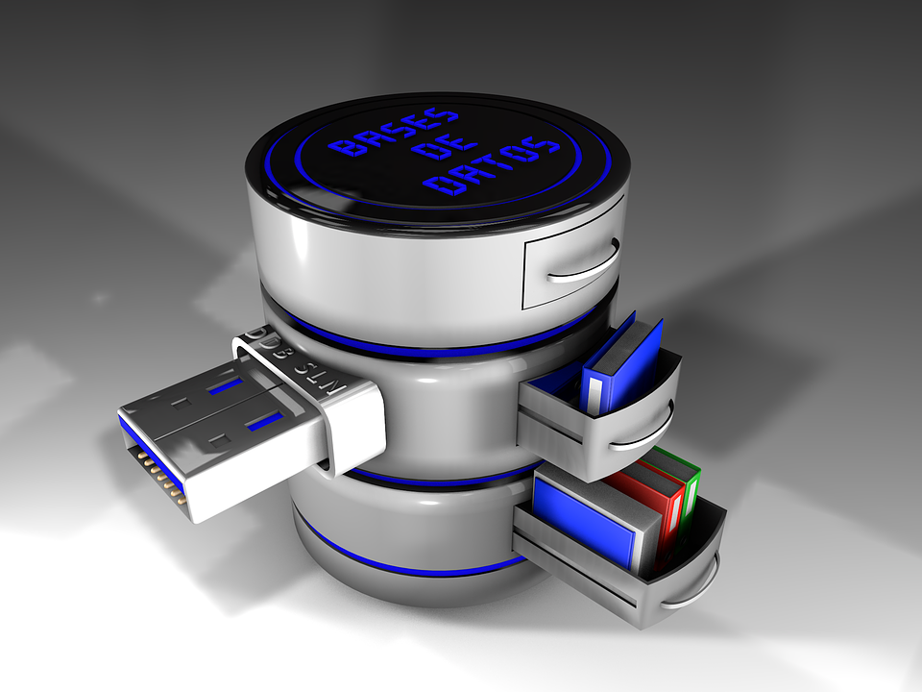

Evaluetor connects contracts with the outside world, using connecters to where conditions are measurable (e.g. Volumes@ERP, SLA@ServiceNow, FX@ECB website)
01
02
03
04
Upload
AI Extracts
Dashboards
Take Action
Reference relevant data from defined external sources
Compare actuals versus agreed in Contract
Alert discrepancies as per defined governance
Monitor improvement actions
Present Contract Performance details
Repeat as per agreed intervals
Continues Control Cycle
by
Agentic AI Agents
Load contract documents:
MSA, Schedules, etc.
Structured & Analysed
With assigned external data sources for comparison

Slide 5
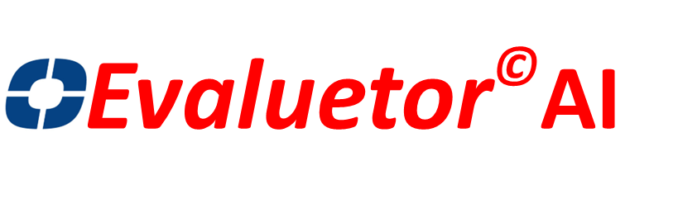
One platform. Complete intelligence. From upload to intelligence in minutes
01
02
03
04
Upload
AI Extracts
Dashboards
Take Action
Drop any PDF, DOCX, or batch upload a ZIP. OCR handles scans.
9 agents extract metadata, clauses, obligations, SLAs, risks, and renewals.
Real-time dashboards surface risks, deadlines, SLA breaches, and vendor scores.
Claim credits, meet deadlines, renegotiate. terms, govern relationships with data
No templates. No pre-configuration. No training required. Just upload and go.
Contract Intelligence
Obligation Tracking
SLA Monitoring
AI extracts metadata, 30+ clause types, and risks across 10 categories. Full semantic search across entire portfolio.
RAG status indicators, owner assignment, escalation paths, and automated deadline alerts. Never miss a commitment.
Real-time breach detection, service credit calculation, and vendor scorecards. Know when performance falls short.
specialized AI agents extract, analyze, and monitor everything in your contracts automatically.
Renewal Management
Relationship Governance
Enterprise Security
Auto-renewal detection, notice period tracking, and AI-powered renewal recommendations. Stay ahead of every date.
KPI perception gap analysis, vendor health scores, satisfaction surveys, and improvement tracking. Only available in Evaluetor.
SOC 2 Type II, GDPR-ready, AES-256 encryption, SSO/SAML, role-based access, full audit trails.

Slide 6
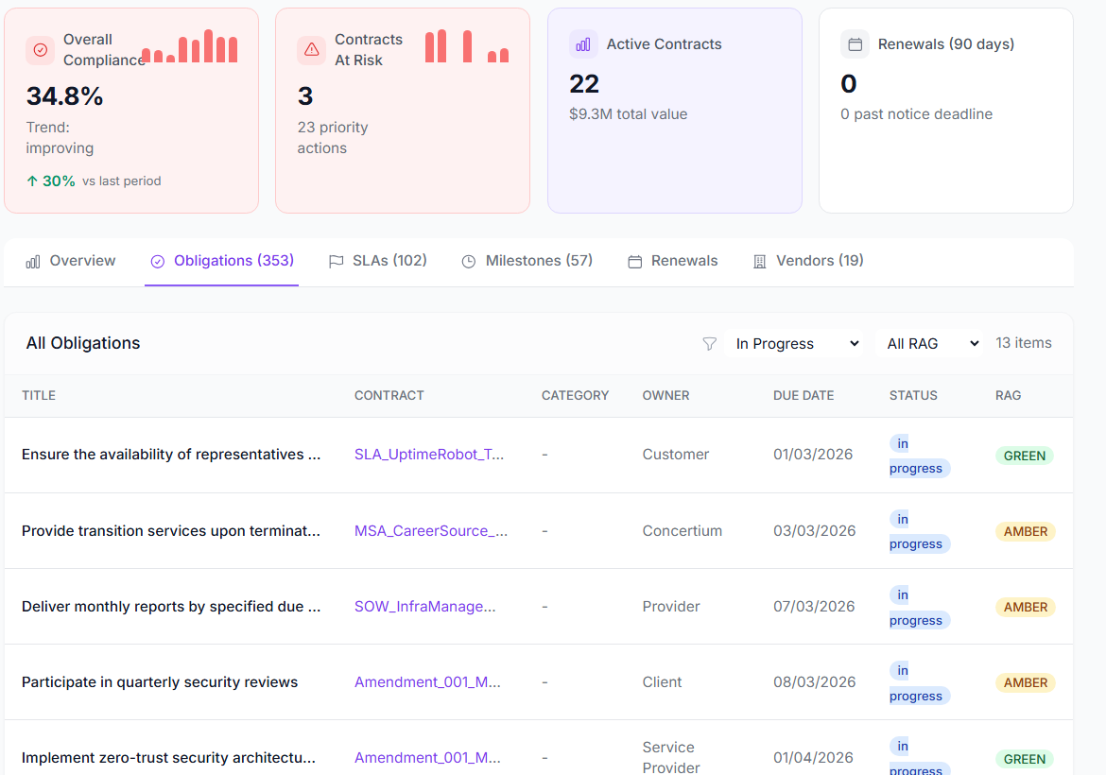
Obligation Tracking: never miss a commitment
Missed obligations cost money, damage relationships, and create compliance exposure. Evaluetor extracts every obligation from every contract and tracks them through their full lifecycle with owners, deadlines, and evidence.
The Obligation Lifecycle
Key Capabilities
From extraction to compliance proof:
RAG Status Dashboard
1
AI Extraction
Obligations identified with deadlines, parties, and consequences
At-a-glance compliance visibility across your entire portfolio. Red flags overdue items, amber shows approaching deadlines, green confirms on-track — filterable by vendor, business unit, or contract type.
2
Classification
7 types: delivery, reporting, payment, regulatory, performance, notice, compliance
Configurable Deadline Alerts
3
Owner Assignment
Each obligation assigned to a responsible person with escalation path
Automated notifications at configurable lead times before each deadline. Alerts route to obligation owners via email, Slack, or Microsoft Teams — with escalation when deadlines are missed.
4
Status Tracking
RAG indicators (Red / Amber / Green) updated as deadlines approach
Compliance Reporting
5
Evidence & Audit
Compliance evidence attached for audit trails and reporting
Generate compliance reports by date range, vendor, or obligation type. Track fulfilment rates over time with trend analysis. Attach evidence documents for audit readiness.

Slide 7
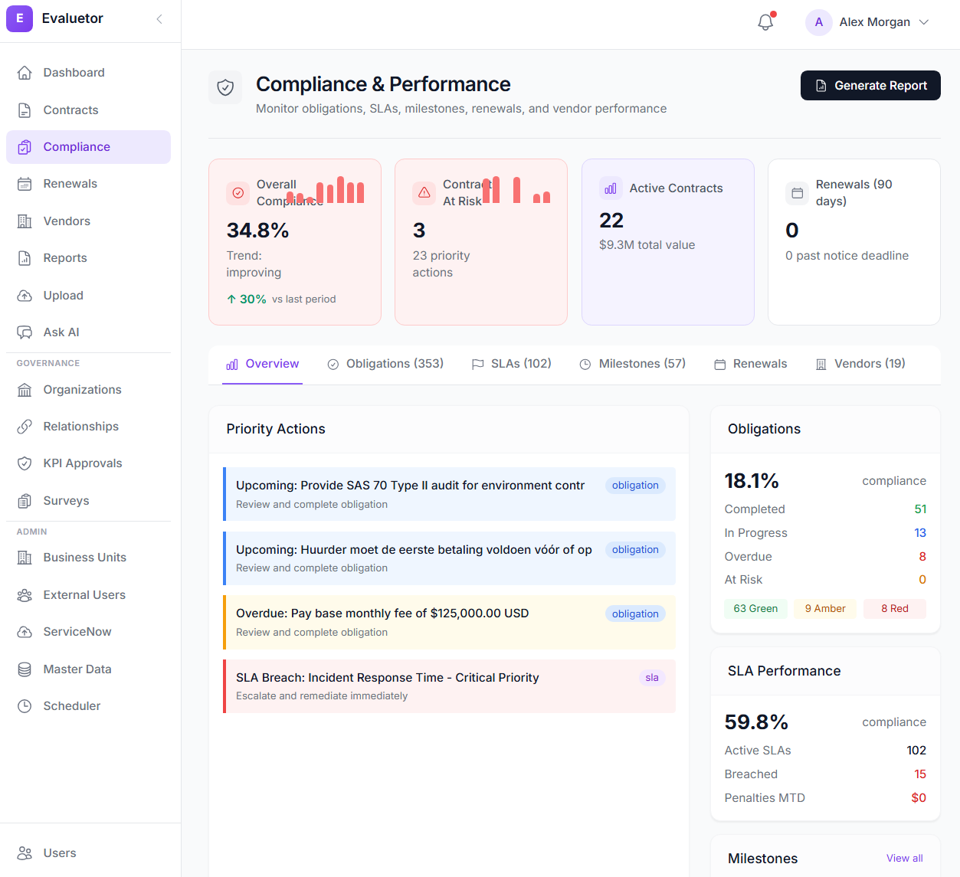
Risk Detection: see what others miss
Every contract carries risk, hidden indemnities, uncapped liabilities, ambiguous termination clauses.
Evaluetor’s AI scores and categories risk automatically so your team can focus on what matters most.
How Risk Analysis Works
Key Capabilities
Fully automated from upload to alert:
10 Risk Categories
1
Document Parsing
Text extracted from PDF, DOCX, or scanned images via OCR
Indemnification, liability caps, IP assignment, termination, confidentiality, non-compete, data protection, insurance, warranty, and force majeure — each scored with weighted severity from 0–100.
2
Clause Classification
AI identifies 30+ clause types across the full document
Cross-Contract Anomaly Detection
3
Risk Categorisation
Each clause scored across 10 risk categories
Knowledge graph compares terms across your portfolio and flags deviations from your norms. Example: “This vendor usually has 30-day payment terms — this contract has 45.”
4
Severity Scoring
4-level scale: Low, Medium, High, Critical with confidence
Portfolio Risk Dashboard
5
Portfolio Alerts
High-risk items surfaced on dashboards with recommended actions
Aggregate risk posture across all contracts with drill-down by vendor, contract type, business unit, or risk category. Trend analysis shows whether your portfolio risk is improving over time.

Slide 8
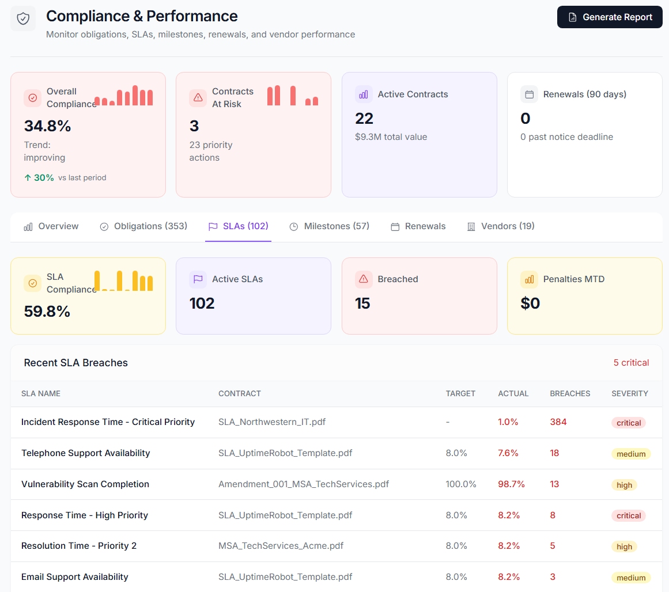
SLA Monitoring: recover what you’re owed
SLA breaches happen constantly, the challenge is detecting them.
Evaluetor extracts SLA terms, compares them against actual performance, and calculates every service credit you’re entitled to.
From Contract to Credit Recovery
Key Capabilities
Automated end-to-end:
9 SLA Metric Types
1
SLA Extraction
AI identifies metrics, targets, measurement periods, and penalties
Uptime, Response Time, Resolution Time, Throughput, Error Rate, Availability, Latency, MTTR, and Custom metrics — each with targets, thresholds, and measurement windows extracted by AI.
2
Performance Ingestion
Actual performance data imported via API or manual entry
Service Credit Recovery
3
Threshold Comparison
Contracted targets compared against actuals in real time
Automatic calculation of credits owed based on breach severity and contract terms. Track recovery status from detection through claim to resolution. Customers report 3–5x more credits found.
4
Breach Detection
Violations classified by severity: Minor, Moderate, Major, Critical
Vendor Scorecards
5
Credit Calculation
Service credits and penalties computed automatically per contract terms
A–F grade vendor ratings combining SLA compliance rate, breach frequency, financial impact, and trend direction. Compare vendor performance across your portfolio with historical benchmarking.

Slide 9
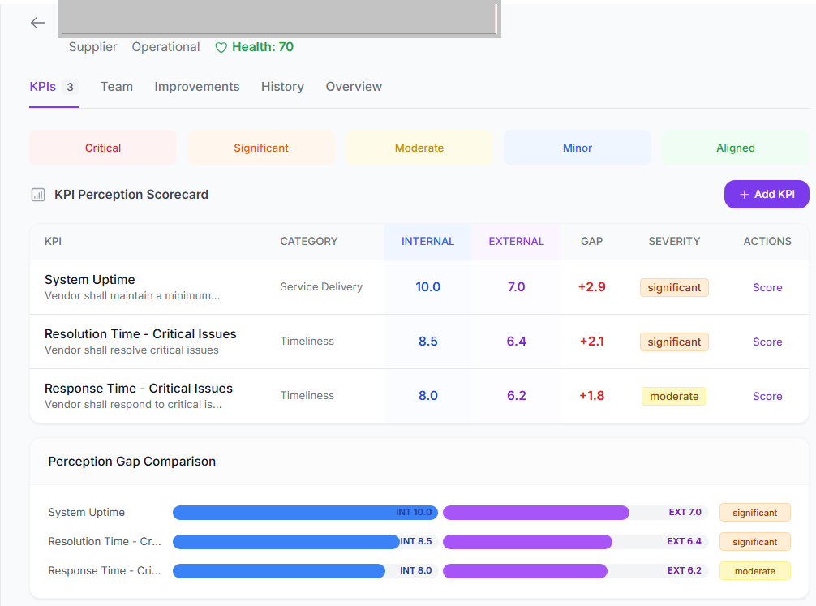
Relationship Governance: only in Evaluetor
Most CLM platforms stop at the contract. Evaluetor goes further, automatically connecting contract data to the business relationships they support.
No other CLM vendor offers this capability.
The Automated Governance Bridge
What Makes This Unique
Contract upload triggers a fully automated pipeline:
Perception Gap Analysis
1
Contract Upload
AI extracts parties, terms, SLAs, and obligations
Dual-perspective scoring reveals misalignment between how you see vendor performance and how they see it — with severity classification that drives targeted improvement.
2
Organizations
Counterparties auto-linked to your org directory
Composite Health Scoring
3
Relationships
Business relationships created with health scoring
Relationship health calculated from Risk (30%), SLA Compliance (40%), and Obligation Fulfillment (30%) — a single score that tells you where each relationship truly stands.
4
KPIs & Scoring
Performance metrics tracked with dual-perspective scoring
Automated Improvement Tracking
5
Improvement Points
Gaps automatically surface with action recommendations
When perception gaps exceed thresholds, improvement points are auto-generated with ownership, priority, and action items. From insight to action without manual intervention.

Slide 10
Measurable impact from day one
Immediate, quantifiable results — not months of implementation before you see
VALUE.
90%
3–5x
95%
$2M+
Less time reviewing contracts
More SLA credits recovered
Fewer missed deadlines
Credits recovered across customers
For Legal
For Procurement
For Finance
Days of contract review compressed to minutes. Automated risk scoring across 10 categories. Portfolio-wide semantic search.
Real-time SLA monitoring. Detect breaches the moment they happen. Recover every service credit owed.
Track every obligation and deadline. Detect auto-renewal traps before they trigger. Understand true financial exposure.

Slide 11
Value delivered
Increase return on contract base
by 3-6%
Developed by seasoned industry experts
Increase renewal rate
and
Contract extensions
Trusted Transparent relationship
Avoid transition costs
Improve margins (decrease costs)
Pro-actively action commitments and avoid omissions
Increase revenue
Growth of add-on business within the existing customer portfolio
Let’s schedule a live Goto Login →

Slide 12

Contact
Steven Visser
Managing Partner - Evaluetor©AI
Burgemeester Le Fevre de Montignylaan 264 3055 NK Rotterdam
The Netherlands Mobile: +31 (0) 631003495 Steven.Visser@Evaluetor.com www.Evaluetor.com

Slide 13
AI-native. Not AI-bolted-on.
Legacy CLM tools added AI as an afterthought.
We built intelligence into the foundation.
Capability | Evaluetor | DocuSign CLM | Icertis | Ironclad
Time to Value | Hours | 6–12 months | 12–18 months | 3–6 months
AI Extraction | 9 native agents | Limited | Add-on | Limited
SLA Monitoring | Built-in | No | Add-on | No
Obligation Tracking | AI-extracted | Manual | Manual | Limited
Relationship Governance | Built-in | No | No | No
Knowledge Graph | Built-in | No | No | No
Unlimited Users | ✓ Yes | ✗ | ✗ | ✗
LLM Observability | Langfuse | No | No | No

Slide 14
Backup slides

Slide 15




Supporting the Contract lifecycle
Vervang met uitspraken ukt bedrijven… : e.g. volume dicountMultistrat
CLIENT
Scope change
dissatisfaction
complaint
Scope change
Add-on
dispute
Legislation change
New requirement
Contracting
execution
Close/renewal
SUPPLIER

